Slide 1
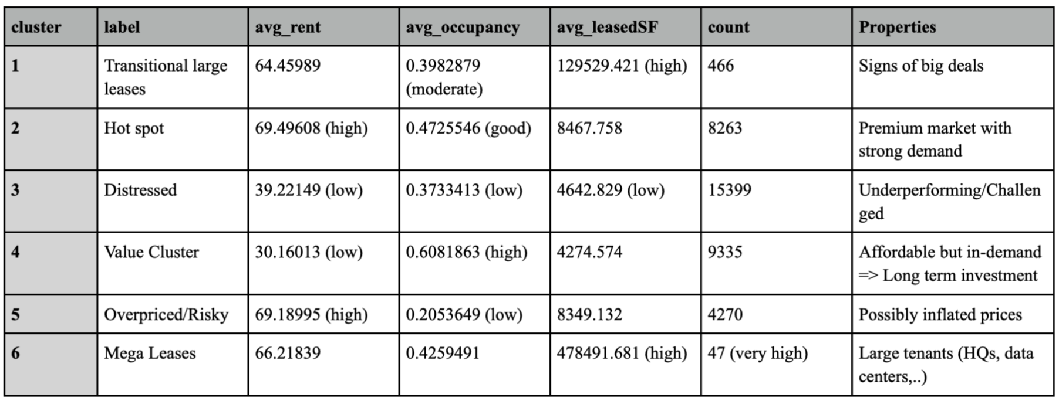
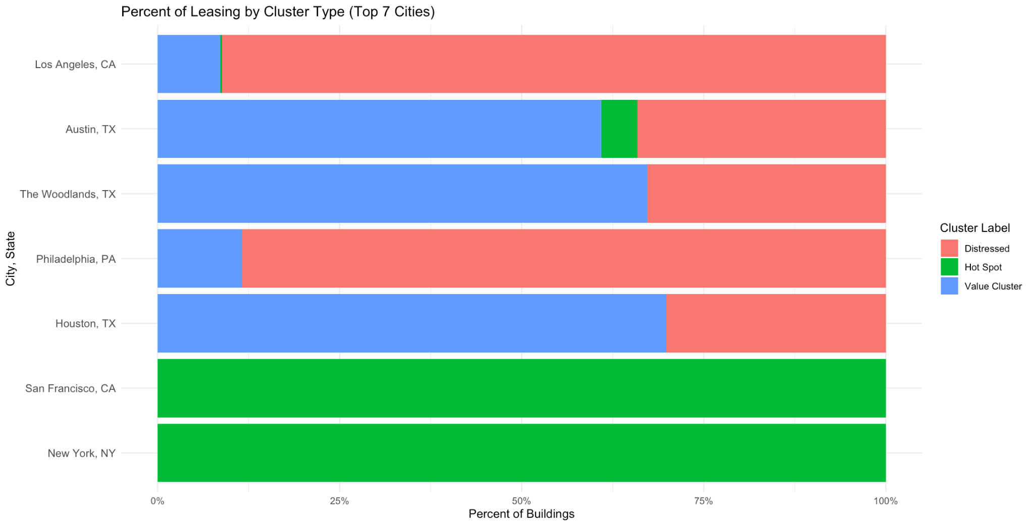
Objective: Specify where and when to lease offices based on geographic clusters and industry sectors.
GENERAL FRAMEWORK
The Elbow Method # of clusters
Label assigned based on characteristics
Top 7 cities with the highest lease.sf are considered
Each city is grouped based on prevalent clusters

Slide 2
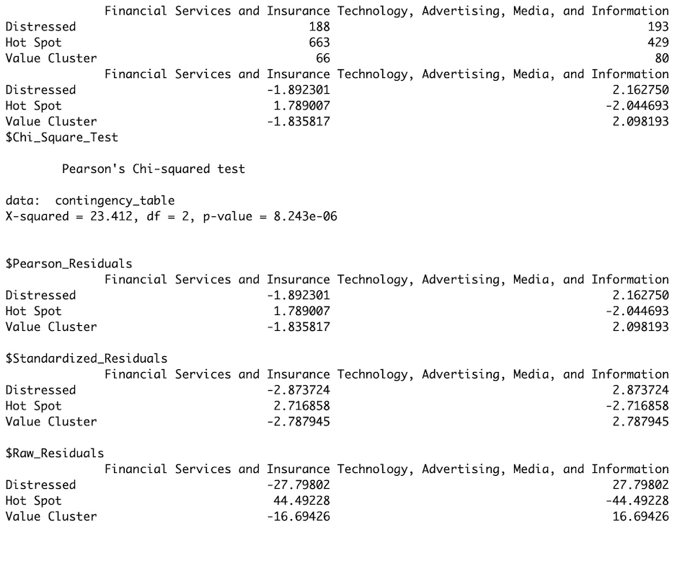
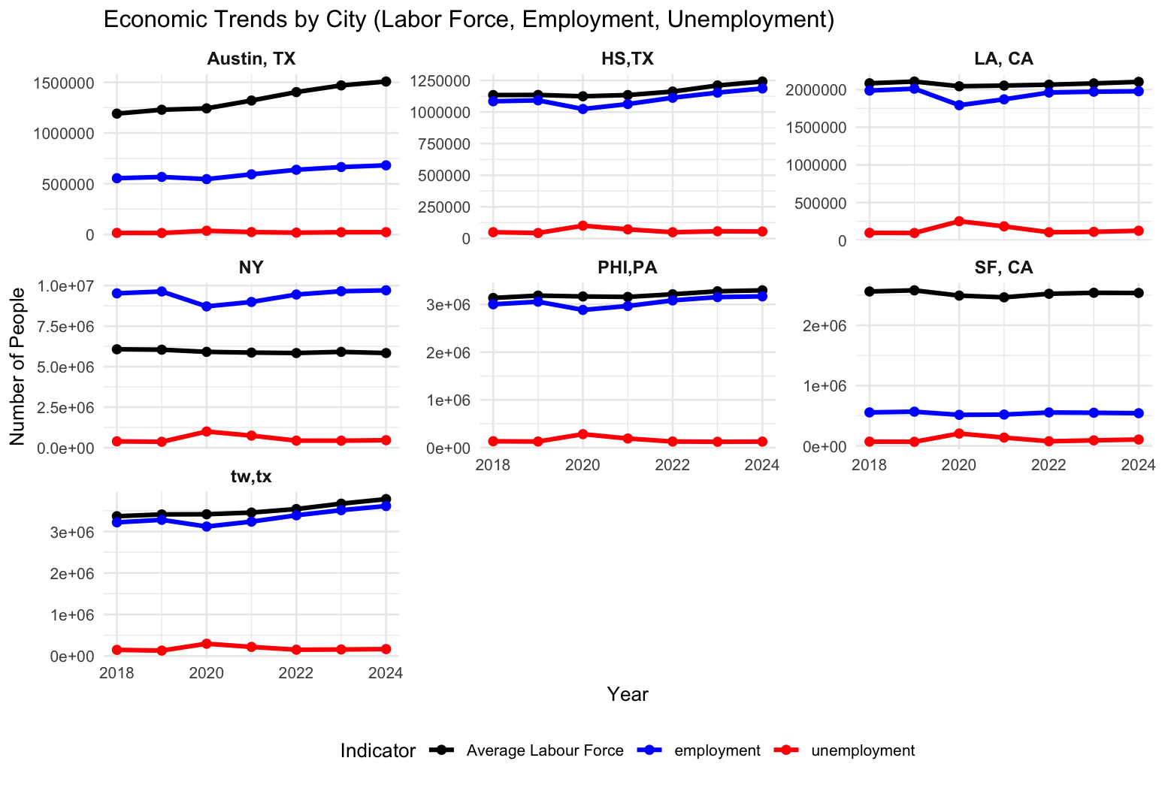
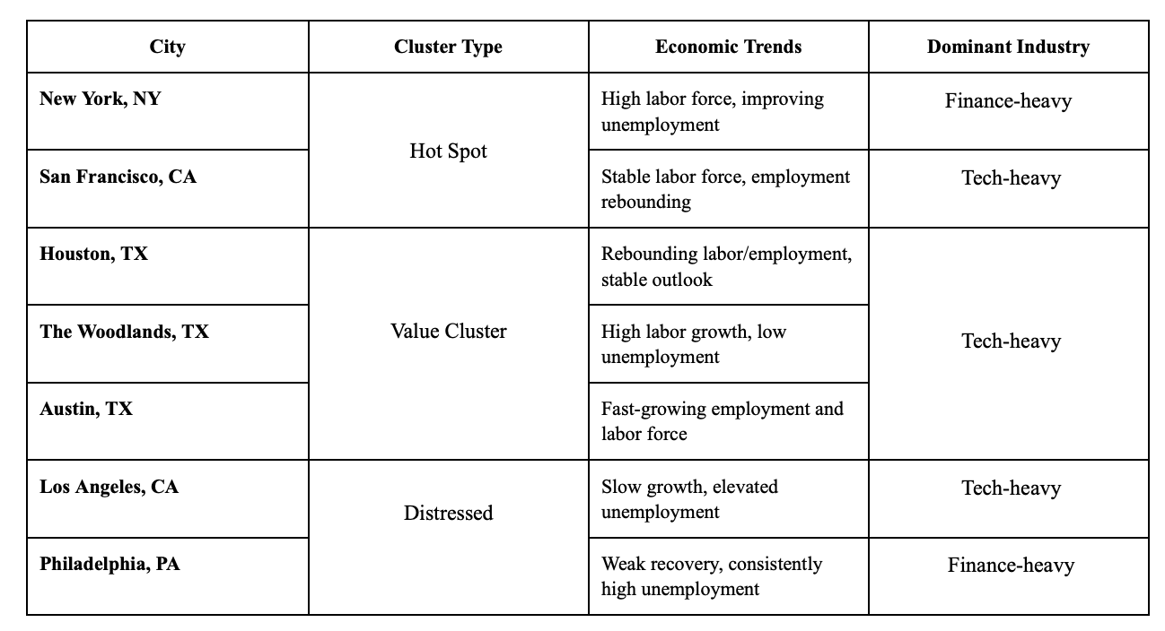
Chi-test: Proven correlation between cluster type and the two sectors
Average labor force, employment and unemployment rates help firms to see:
Pools of labor
Economic growth
=> Tailored to firm’s conditions and needs (startup, budget-conscious,..)
WHERE TO MOVE IN

Slide 3
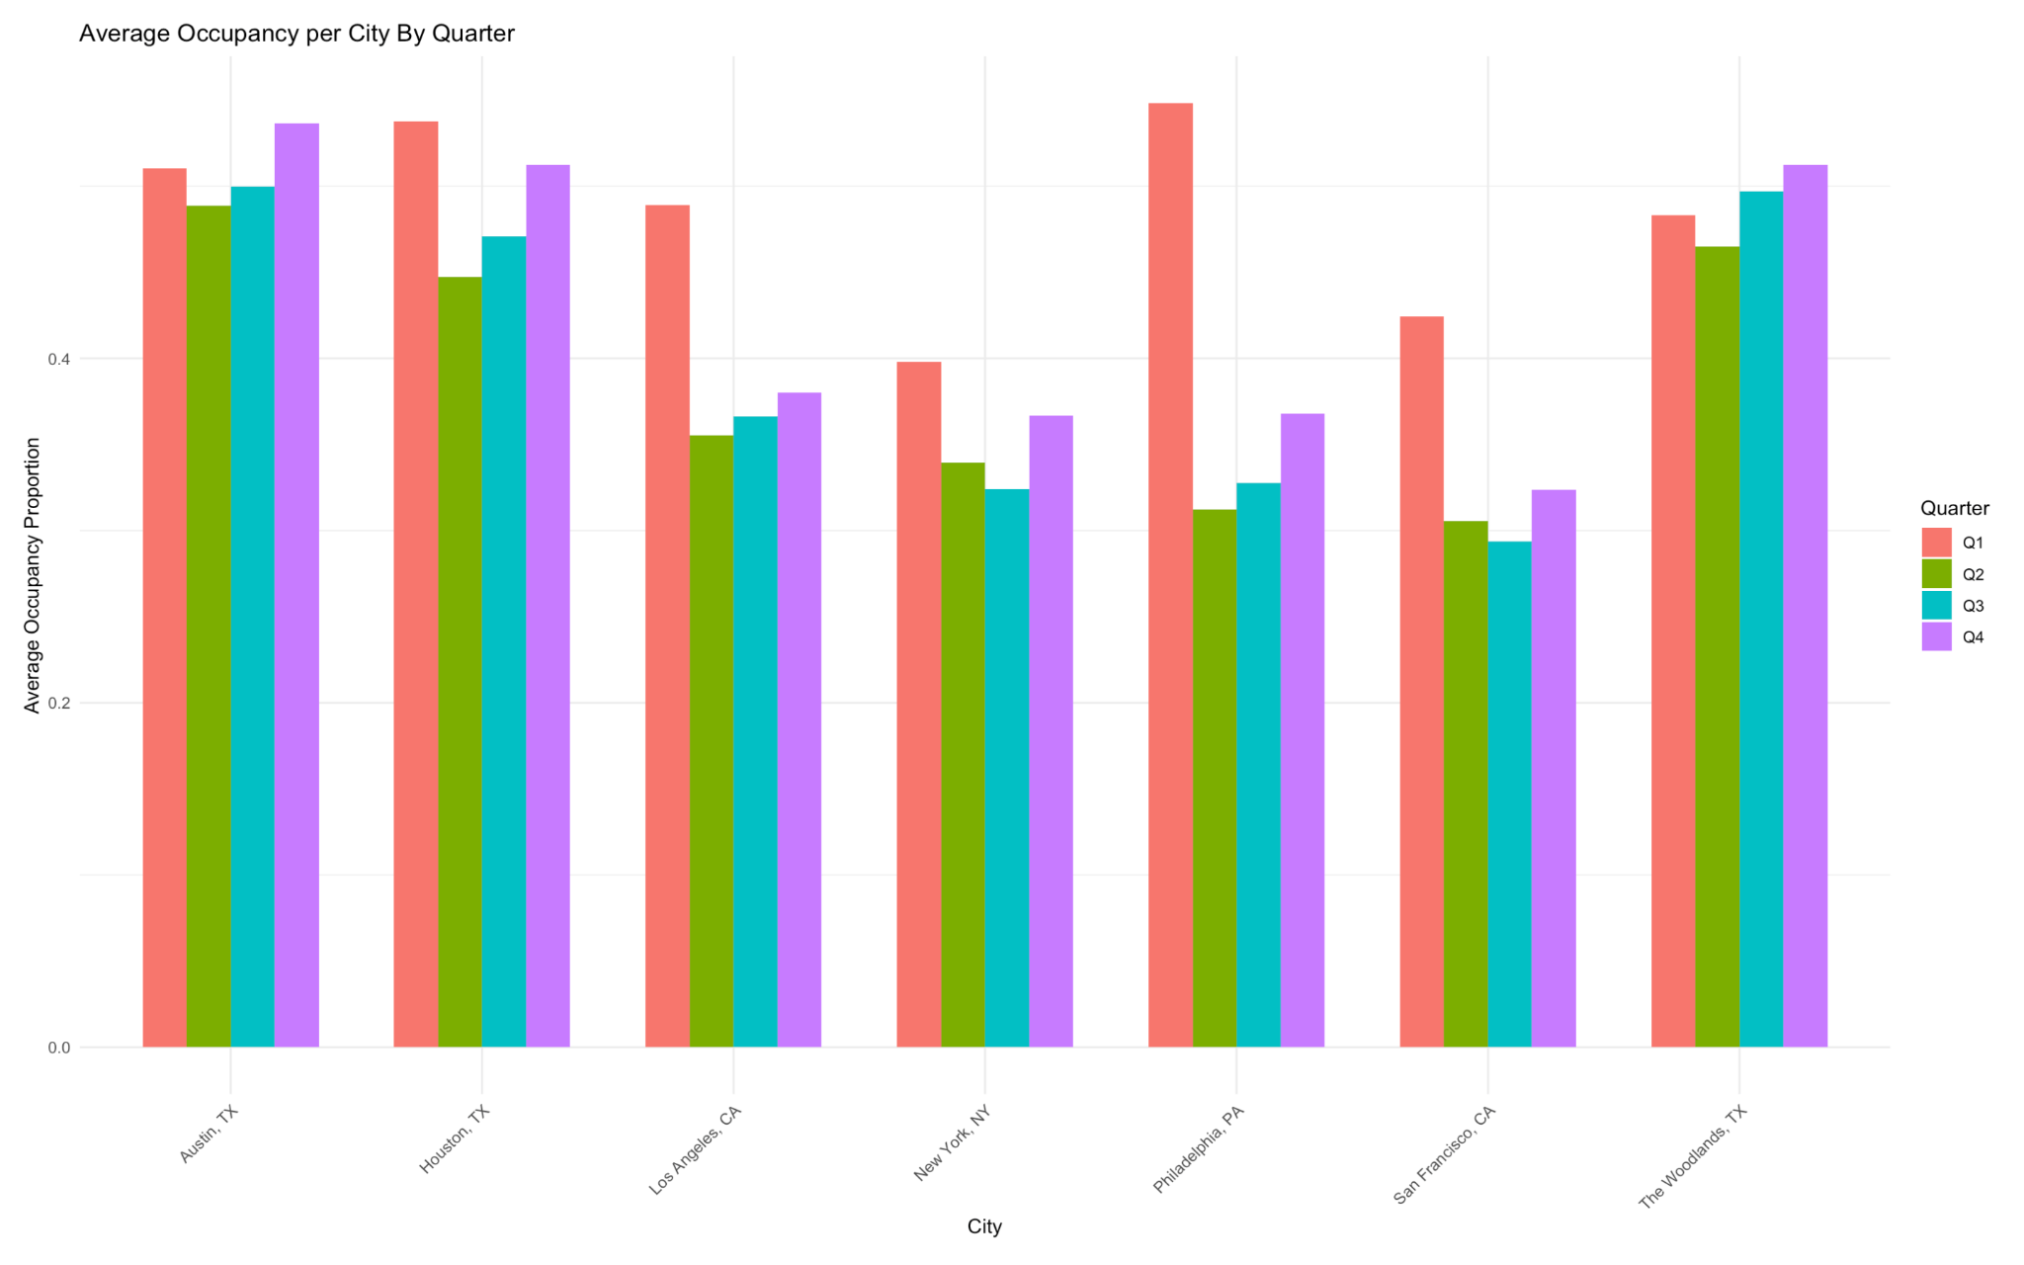
WHEN TO MOVE IN
Average Occupancy Proportion Per Quarter
Lower occupancy proportions were often observed in Q2 and Q3
0.4
0.2
Austin, TX
0.0
Houston. TX
Philadelphia,
PA
New York, NY
The Woodlands,
TX
Los Angeles, CA
H0: (μ1​+μ4)/2 ​= (μ2​+μ3​)/2
HA: (μ1​+μ4)/2 ​≠ (μ2​+μ3​)/2​
t-value = 2.1658
p_value = 0.0397 < 0.005
→ moderate evidence
San Francisco, CA
Hot Spot
Value Cluster
Distressed

